Slide 1

8600-342: Developing Own Leadership Capability Using Action Learning
Business Administration

Slide 2

8600-342: Developing Own Leadership Capability Using Action Learning
Week Three
Notes:
Management Communication

Slide 3
Assignment Questions
Explain the nature and benefits of action learning (8 marks)
Explain the responsibilities of an individual within an action learning set or group including confidentiality and respect for others (4 marks)
Identify own leadership strengths and limitations based on an assessment of own leadership behaviours and potential (12 marks)
Set personal goals for an extended action learning intervention (8 marks)
Prepare individual action learning plans for involvement in action learning sessions for a minimum of twenty hours (12 marks)

Slide 4
Assignment Questions
Complete planned actions to improve leadership (16 marks)
Monitor and record own participation in action learning sessions (16 marks)
Use feedback from others and own personal reflections to review the effectiveness of action learning undertaken (16 marks)
Identify follow up actions required to continue the leadership journey (8 marks)

Slide 5
Content
Goal Setting
Goal Setting in Business
Goal Commitment
Types of Goal in Theoretical Perspective
SMART Goal Theory
Goal Setting Limitations
7 Tips to Setting Personal Goals
Learning Goals and Performance Goals
Practical Applications of Learning Goals

Slide 6
Goal Setting
Goals that are deemed difficult to achieve and specific tend to increase performance more than goals that are not. A goal can become more specific through quantification or enumeration (should be measurable).
In business, goal setting encourages participants to put in substantial effort. Also, because every member has defined expectations for their role, little room is left for inadequate, marginal effort to go unnoticed.
Managers cannot constantly drive motivation, or keep track of an employee’s work on a continuous basis. Goals are therefore an important tool for managers, since goals have the ability to function as a self-regulatory mechanism that helps employees prioritize tasks.

Slide 7
Goal Setting
Setting goals affects outcomes in four ways:
Choice: goals narrow attention and direct efforts to goal-relevant activities, and away from perceived undesirable and goal-irrelevant actions.
Effort: goals can lead to more effort; for example, if one typically produces 4 widgets an hour, and has the goal of producing 6, one may work more intensely towards the goal than one would otherwise.
Persistence: someone becomes more prone to work through setbacks if pursuing a goal.
Cognition: goals can lead individuals to develop and change their behaviour.

Slide 8
Goal Setting in Business
The four mechanisms through which goal setting can affect individual performance are:
Goals focus attention toward goal-relevant activities and away from goal-irrelevant activities.
Goals serve as an energizer: Higher goals induce greater effort, while low goals induce lesser effort.
Goals affect persistence; constraints with regard to resources affect work pace.
Goals activate cognitive knowledge and strategies that help employees cope with the situation at hand.

Slide 9
Goal Commitment
People perform better when they are committed to achieving certain goals. Through an understanding of the effect of goal setting on individual performance, organizations are able to use goal setting to benefit organizational performance. Locke and Latham have indicated three moderators that indicate goal setting success:
The importance of the expected outcomes of goal attainment, and;
Self-efficacy – one's belief that they are able to achieve the goals, and;
Commitment to others – promises or engagements to others can strongly improve commitment.

Slide 10
Types of Goal in Theoretical Perspective
Goal choice-Self-efficacy, past performance and various other social factors influence goal setting.^{[1]} Failure to meet previous goals often leads to setting lower (and more likely achievable) goals.
Learning goals -There are times when having specific goals is not a best option; this is the case when the goal requires new skills or knowledge. “Tunnel vision” is a consequence of specific goals; if one is too focused on attaining a specific goal they ignore the need to learn new skills or acquire new information.
Framing- How goals are viewed influences performance. When one feels threatened and or intimidated by a high goal they perform poorer than those who view the goal as a challenge.

Slide 11
Types of Goal in Theoretical Perspective
Affect- Realization of goals has an effect on feelings of success and satisfaction. Achieving goals has a positive effect, and failing to meet goals has negative consequences. However, the affect of goals is not exclusive to one realm.
Group goals- The relationship between group goals and individual goals influences group performance; when goals are compatible there is a positive effect, but when goals are incompatible the effects can be detrimental to the group’s performance
Macro-level goals- This is goal setting applied to the company as a whole. Cooperative goals reduce the negative feelings that occur as a result of alliances and the formation of groups.

Slide 12
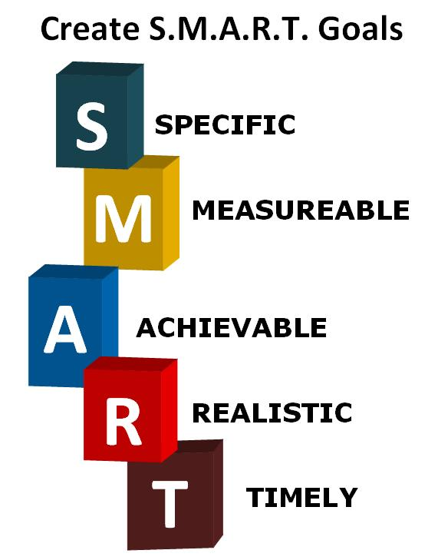
SMART Goal Theory

Slide 13
SMART Goal Theory
Specific-The first criterion stresses the need for a specific goal rather than a more general one. This means the goal is clear and unambiguous; without vagaries and platitudes. To make goals specific, they must tell a team exactly what is expected, why is it important, who’s involved, where is it going to happen and which attributes are important. A specific goal will usually answer the five "W" questions:
What: What do I want to accomplish?
Why: Specific reasons, purpose or benefits of accomplishing the goal.
Who: Who is involved?
Where: Identify a location.
Which: Identify requirements and constraints.

Slide 14
SMART Goal Theory
Measurable-The second criterion stresses the need for concrete criteria for measuring progress toward the attainment of the goal. The thought behind this is that if a goal is not measurable, it is not possible to know whether a team is making progress toward successful completion.
Measuring progress is supposed to help a team stay on track, reach its target dates, and experience the exhilaration of achievement that spurs it on to continued effort required to reach the ultimate goal. A measurable goal will usually answer questions such as:
How much?
How many?
How will I know when it is accomplished?

Slide 15
SMART Goal Theory
Attainable- The third criterion stresses the importance of goals that are realistic and attainable. While an attainable goal may stretch a team in order to achieve it, the goal is not extreme. That is, the goals are neither out of reach nor below standard performance, as these may be considered meaningless.
The theory states that an attainable goal may cause goal-setters to identify previously overlooked opportunities to bring themselves closer to the achievement of their goals.
An attainable goal will usually answer the question:
How: How can the goal be accomplished?

Slide 16
SMART Goal Theory
Relevant-Relevant goals (when met) drive the team, department, and organization forward. A goal that supports or is in alignment with other goals would be considered a relevant goal.
A relevant goal can answer yes to these questions:
Does this seem worthwhile?
Is this the right time?
Does this match our other efforts/needs?
Are you the right person?
Is it applicable in current socio- economic- technical environment?

Slide 17
SMART Goal Theory
Time-bound- A commitment to a deadline helps a team focus their efforts on completion of the goal on or before the due date. This part of the SMART goal criteria is intended to prevent goals from being overtaken by the day-to-day crises that invariably arise in an organization. A time-bound goal is intended to establish a sense of urgency.
A time-bound goal will usually answer the question:
When?
What can I do six months from now?
What can I do six weeks from now?
What can I do today?

Slide 18
Goal Setting Limitations
In an organization, a goal of a manager may not align with the goals of the organization as a whole. In such cases, the goals of an individual may come into direct conflict with the employing organization. Without aligning goals between the organization and the individual, performance may suffer.
For complex tasks, goal-setting may actually impair performance. In these situations, an individual may become preoccupied with meeting the goals, rather than performing tasks.
Some evidence suggests that goal-setting can foster unethical behaviour when people do not achieve specified goals.

Slide 19
7 Tips to Setting Personal Goals
One: Decide What it is That You Really Want
Deciding exactly what you want is always the first step. But what if you don’t know what you want?
These thoughts can be setting financial goals, setting career goals, setting business goals, relationship goals, health goals or any desire that you feel right for yourself.
Being able to really pin point a goal you need clarity and going after something that you really want, you must stay positive

Slide 20
7 Tips to Setting Personal Goals
Two: Getting Use To Writing and Why You Should Start Now
One of the most things people don’t realize is that when you set your goals, and you get all excited about, you’re ready to take action, but than a couple of days later you forget about it or procrastinate because you doing know where to start and end up giving up.
Write down what you want and list the steps how you’re going to achieve it. This is something that I continue to do on the daily. Keep a small note pad with you and look at it often, daily, day and night

Slide 21
7 Tips to Setting Personal Goals
Three: How to Set A Deadline
You should look at your calendar and decide on a day but its usually a day off, a week off, or even a month.
Things can show up and hold you back from getting to the day you set as a deadline, and this is okay, just know that you will reach it and feel that feeling of how bad you want it. As long as you stay focused, there is no choice but to reach it. It doesn’t matter if your deadline isn’t right where you set it. Keep going.

Slide 22
7 Tips to Setting Personal Goals
Four: Increase Productivity by Breaking it Down
A lot of people seem to give up on goals because they don’t know where to begin. Days pass, weeks pass, and the goal fades into another dream.
This is why people procrastinate; you don’t know where to start. Here is the solution, as you write down your goal, add steps to the goal randomly on your note pad. Go back and list them from 1 to 10 or whichever way helps you determine which steps to take first.

Slide 23
7 Tips to Setting Personal Goals
Five: How to Stay Motivated and Get To Your End Result
With this hectic world and laziness environment we surround ourselves. It’s easy to get caught up and forget about your goals or even drop the whole idea.
To get through this, set apart away from work and sit somewhere quiet and visualize the end result. Notice I mention “end result” throughout this article.
It is proven what you see within your mind, you can achieve. Believe that is true and keep focusing on the end result.

Slide 24
7 Tips to Setting Personal Goals
Six: Learn How to Take a Break and Relax
You’er in the zone and want to keep going but your body is tired. Even though you’re doing well with your list and getting closer to your goal, its ok to take a break. Give your mind and body some time off. A day or two is fine.
This will allow your body re-energized for the next steps ahead. Just make sure when you do, leave everything alone, worrying about what needs to be done will only stress you out. Relax, enjoy the moment of the now.

Slide 25
7 Tips to Setting Personal Goals
Seven: What Should You Do If You Fail and Hit Rock Bottom
This is one that most that everyone fear. To try to attempt a goal but fear they will fail or end up failing after reaching the goal. Fear actually prevent people from going after what they want.
They only want to be in the safe zone and say they rather be safe than sorry. Or, after failing the goal they give up too easily because they fear they will fail again.
The truth is, you don’t know if you will fail; only you know if you will succeed. If you feel that it is something you really want, try it until you succeed or at least to find out if it was for you in the first place

Slide 26
Learning Goals and Performance Goals
Learning goals or performance-outcome goals
That setting specific performance goals can sometimes actually worsen performance is at first glance astonishing in that this conclusion is at odds with the accumulated findings of over a quarter of a century of research in the behavioural sciences.
For at least three decades, this research has shown that goal setting is a powerful and effective motivational technique. Specifically, the research shows again and again that a performance goal influences choice, effort, and the persistence needed to attain it. However, it is often forgotten that performance at a high level is a function of ability as well as motivation.

Slide 27
Learning Goals and Performance Goals
The participants assigned a specific high-learning goal were told to identify and implement six or more strategies for increasing market share. The results revealed that:
1. Performance was highest for individuals who had a specific high learning goal.
2. Individuals who had a learning goal took the time necessary to acquire the knowledge to perform the task effectively and to analyze the task-relevant information that was available to them.
3. Those with a learning goal were convinced that they were capable of mastering the task.
4. Those with a learning goal had a higher commitment to their goal than did those with a performance goal.

Slide 28
Learning goals, Performance Goals and the Efficacy of the Former
The primary distinction between performance and learning goals lies in the framing of the instructions given to employees. Hence, the difference between these two types of goals is first and foremost a “mindset.” The respective instructions focus attention on two different domains-motivation versus ability. A performance goal, as the name implies, frames the instructions so that an employee’s focus is on task performance
In short, learning goals help people progress to the point where performance-outcome goals increase one’s effectiveness. The focus of a learning goal is to increase one’s knowledge (ability); the focus of a performance goal is to increase one’s motivation to implement that knowledge.

Slide 29
Practical Applications of Learning Goals
Based on our findings, as well as the experiences of the CEOs we have cited, there are at least 3 areas where the application of learning goals should prove particularly helpful in improving performance.
1. Leadership
2. Performance management
3. Professional development

Slide 30
Class activity
Setting Your Goal

Slide 31
Reference
http://www.google.com.sg/#q=Set+personal+goals+
http://www.wikihow.com/Set-Goals
http://www.lululemon.com/education/goalsetting
http://www.iamlongle.com/7-tips-to-setting-personal-goals-that-will-inspire-you-to-take-action/
http://iveybusinessjournal.com/topics/leadership/learning-goals-or-performance-goals-is-it-the-journey-or-the-destination#.UnHDgcQZ5Ms
http://www.flexstudy.com/catalog/schpdf.cfm?coursenum=95086
https://www.eduweb.vic.gov.au/edulibrary/public/teachlearn/student/devperslearngoals.pdf

